Slide 1
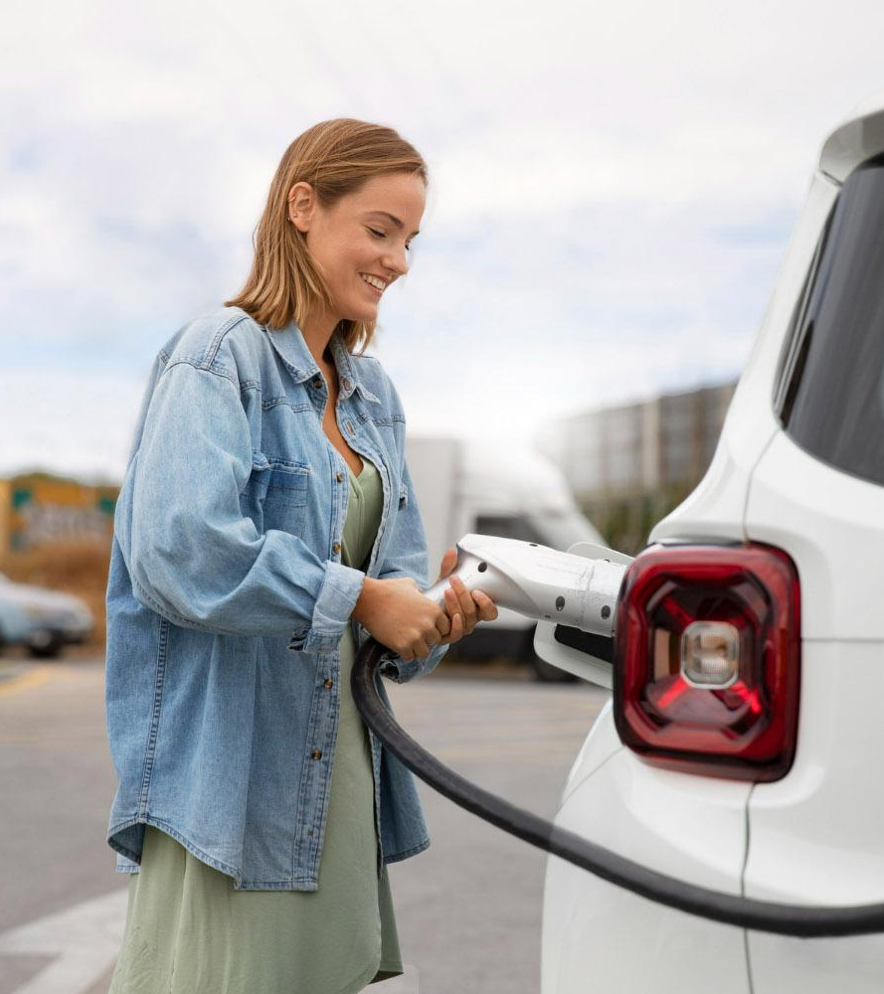
Plug & Power: Revolutionizing the Road
Here is where your presentation begins

Slide 2
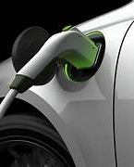
INTRODUCTION

Slide 3
Welcome to "Plug & Power: Revolutionizing the Road - A Complete Guide to Electric Vehicle Charging Stations." In this electrifying journey, we will explore how Electric Vehicle Charging Stations, often referred to as "Plug & Power" stations, are reshaping the landscape of transportation. As the world shifts towards sustainable and eco-friendly solutions, electric vehicles have emerged as a driving force of change. At the heart of this transformation lies the infrastructure that fuels these vehicles – the charging stations. It is a user friendly application by having many option to make user experience at high level so It will raise the EV usage.

Slide 4
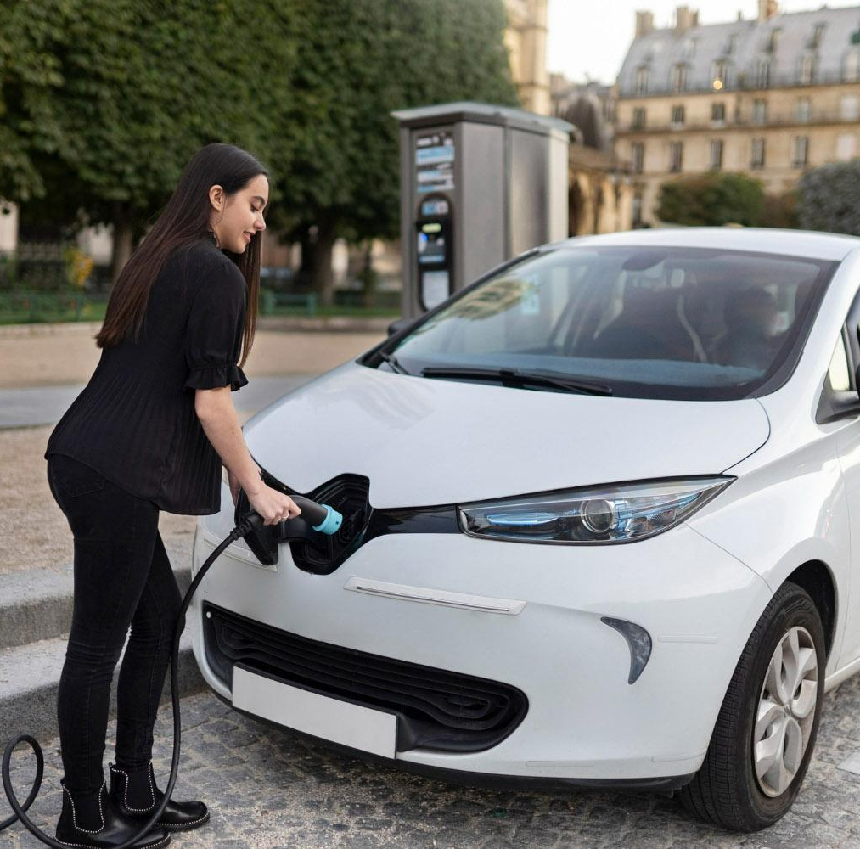
NOVELTY AND UNIQUENESS

Slide 5
01
03
02
04
Energy Cost Estimation
Charging Station Reservation
This could help users make more informed decisions about where to charge based on cost-effectiveness
a reservation system that enables users to reserve a charging spot in advance, ensuring they have a spot available when they arrive at the station.
Charging Queue Management
Augmented Reality Navigation
For busy charging stations, introduce a virtual queue system that lets users join a queue remotely and receivenotifications when it's their turn to charge.
Implement AR navigation that overlays directions and real-time information about charging stations onto the user's smartphone camera view.

Slide 6
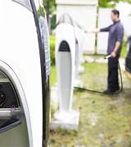
SOCIAL IMPACT

Slide 7
ACCELERATION OF EV ADOPTION
ENVIROMENTAL IMPACT
Increased adoption of electric vehicles could contribute to a cleaner and healthier environment, reducing the overall carbon footprint of transportation.
By addressing range anxiety and providing easy access to charging infrastructure, your project could accelerate the adoption of electric vehicles, leading to a reduction in greenhouse gas emissions and air pollution.
ENERGY TRANSITION
JOB CREATION
The project aligns with the global shift towards renewable energy and energy independence, as electric vehicles can be charged using clean energy sources like solar and wind power.
As the electric vehicle ecosystem expands, the project could indirectly contribute to job creation in areas such as manufacturing, maintenance, and support services for electric vehicles and charging stations.

Slide 8
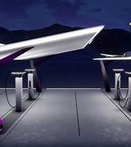
TECHNOLOGIES ARCHITECTURE

Slide 9





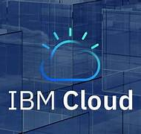
TECHNOLOGY

Slide 10
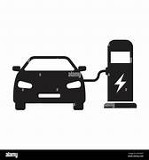
CONCLUSION

Slide 11
In conclusion, "Plug & Power: Revolutionizing the Road" presents a comprehensive and insightful guide to the world of Electric Vehicle (EV) charging stations. The rapid advancement of EV technology and the growing need for sustainable transportation solutions have brought charging infrastructure to the forefront of our modern landscape. This guide has delved deep into the various aspects of EV charging stations, from their importance in reducing carbon emissions and dependence on fossil fuels to the technical nuances of charging standards, station types, and smart technologies.

Slide 12
THANK YOU

Slide 13
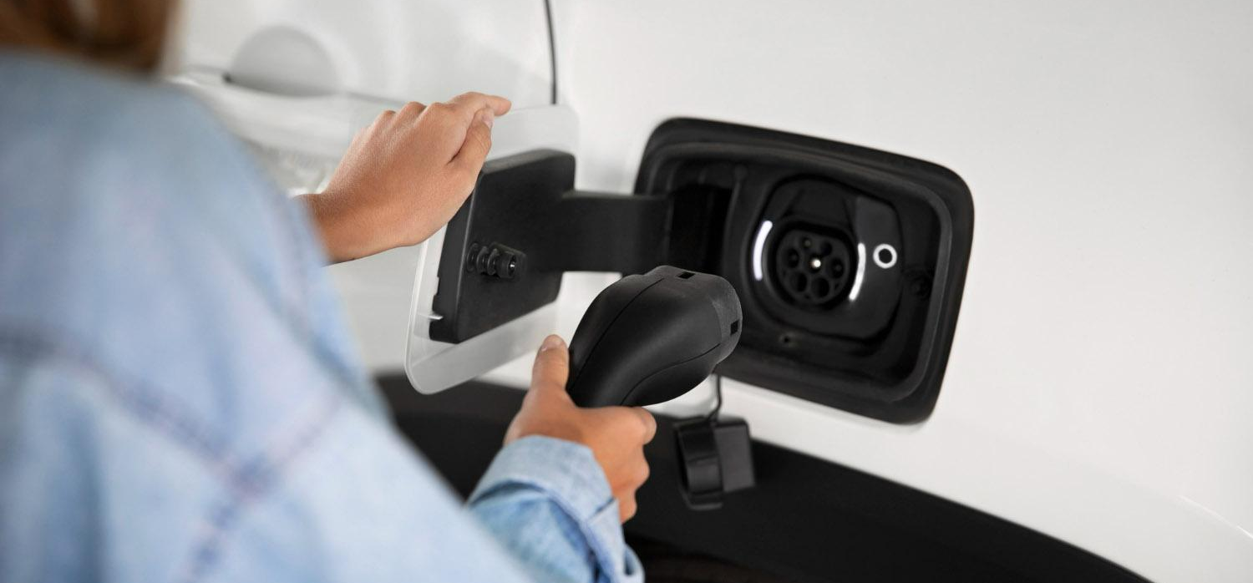
Whoa!
This can be the part of the presentation where you introduce yourself, write your email…

Slide 14
Maybe you need two columns
Mercury
Venus
Mercury is the closest planet to the Sun and the smallest one in the Solar System—it’s only a bit larger than the Moon
Venus has a beautiful name and is the second planet from the Sun. It’s hot and has a poisonous atmosphere

Slide 15
Or maybe you need three columns
Mercury
Venus
Mars
Mercury is the closest planet to the Sun and the smallest one of them all
Venus has a beautiful name and is the second planet from the Sun
Despite being red, Mars is actually a cold place. It’s full of iron oxide dust

Slide 16
Divide the content in four ideas
Mars
Venus
Despite being red, Mars is a very cold place full of iron oxide dust
Venus has a nice name and is the second planet from the Sun
Jupiter
Mercury
Jupiter is a gas giant and the biggest planet in the Solar System
Mercury is the closest planet from the Sun and the smallest one

Slide 17
Here are six important ideas
Mars
Venus
Earth
Mars is actually a very cold place
Venus has extremely high temperatures
Earth is the third planet from the Sun
Mercury
Saturn
Jupiter
Mercury is the closest planet to the Sun
Saturn is a gas giant with several rings
Jupiter is the biggest planet of them all

Slide 18
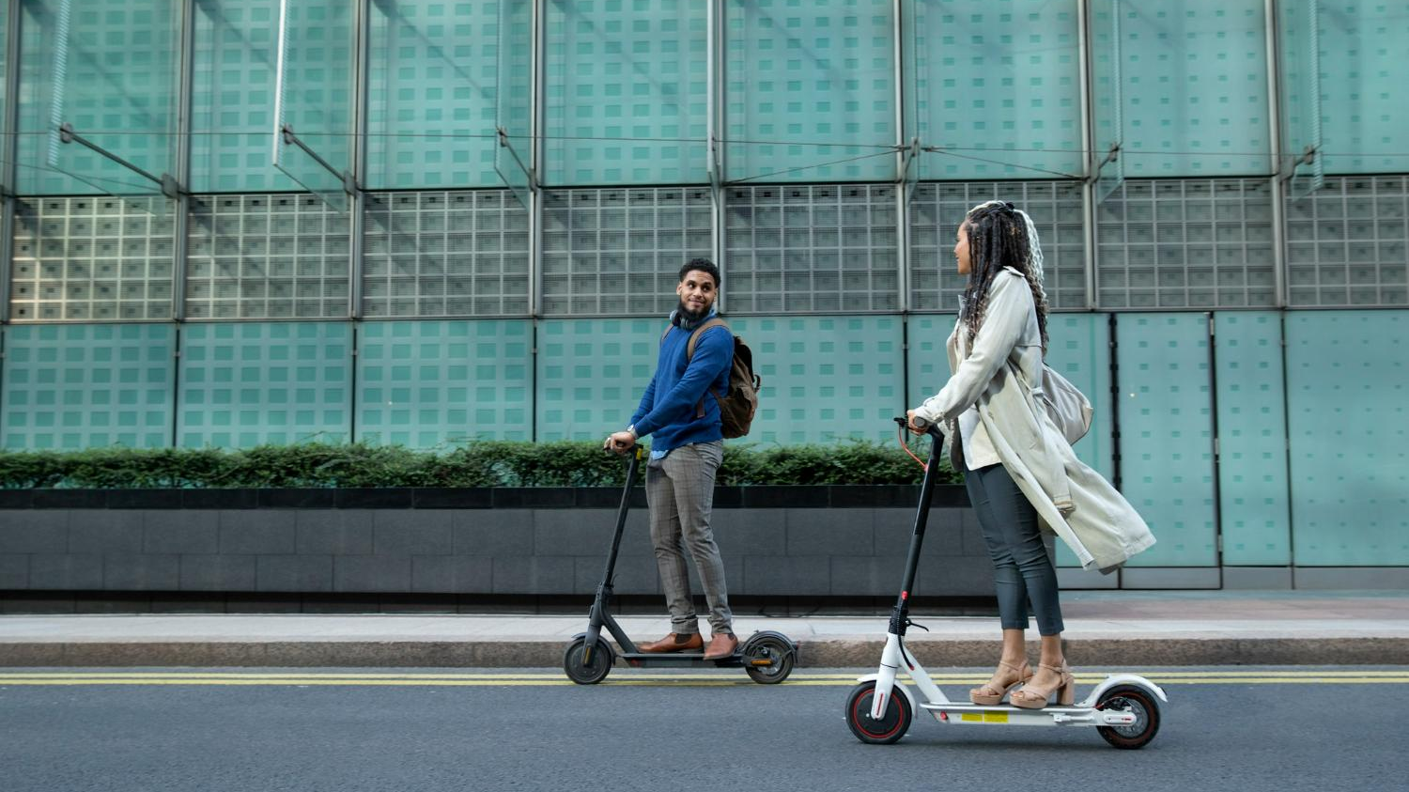
A picture is worth a thousand words

Slide 19
Aspects to be taken into account
 | Venus | Mercury | Mars | Jupiter
Energy sources | Saturn Mercury | Moon Jupiter | Jupiter Neptune | Mars Uranus
Emissions | Yes | Yes | No | Yes
Efficiency | Mars | Ceres | Mercury | Moon
Costs | $10,000 | $30,000 | $5,000 | $26,000
Autonomy | 150 miles | 250 miles | 70 miles | 200 miles

Slide 20
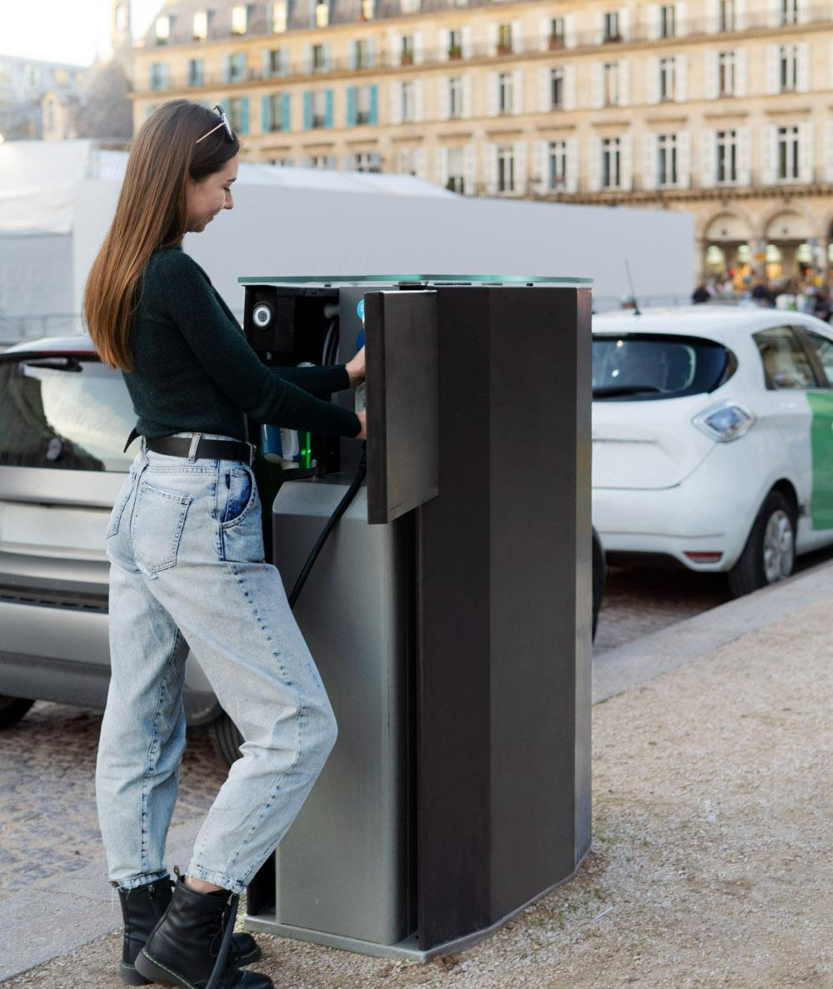
A picture always reinforces the concept
Images reveal large amounts of data, so remember: use an image instead of a long text. Your audience will appreciate it

Slide 21
Five concepts
01
02
03
04
05
Jupiter
Mars
Earth
Jupiter is the biggest planet of them all
Despite being red, Mars is actually a cold place
Earth is the third planet from the Sun
Mercury
Neptune
Mercury is the smallest planet of them all
Neptune is the farthest planet from the Sun

Slide 22
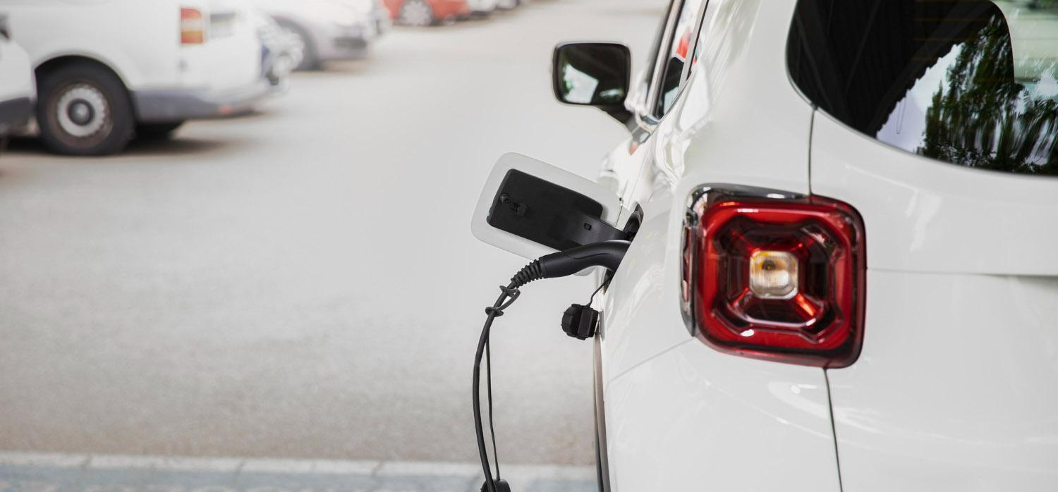
4,498,300,000
Big numbers catch your audience’s attention

Slide 23

9h 55m 23s
333,000
386,000 km
Jupiter’s rotation period
The Sun’s mass compared to Earth’s
Distance between Earth and the Moon

Slide 24
Let’s use some percentages
25%
50%
75%
Mercury
Venus
Mars
Mercury is the closest planet to the Sun and the smallest of them all
Venus has a beautiful name and is the second planet from the Sun
Despite being red, Mars is actually a cold place. It’s full of iron oxide dust

Slide 25
Some tips
Mars
Venus
Jupiter
Earth
Mercury
Despite being red, it’s actually a cold place
Venus is terribly hot, even hotter than Mercury
Jupiter is the biggest planet of them all
Earth is the third planet from the Sun
Mercury is the smallest planet of them all

Slide 26
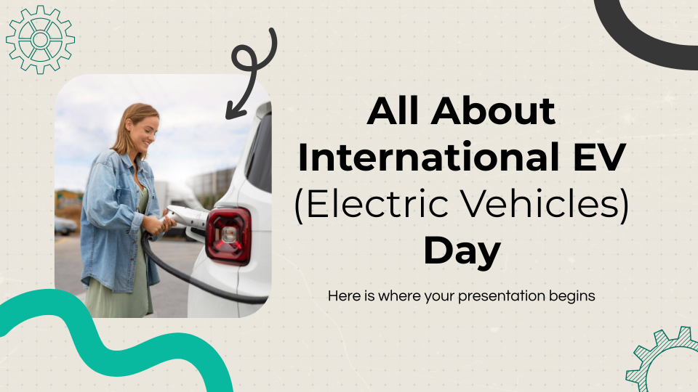
PC mockup
You can replace the image on the screen with your own work. Just right-click on it and select “Replace image”

Slide 27
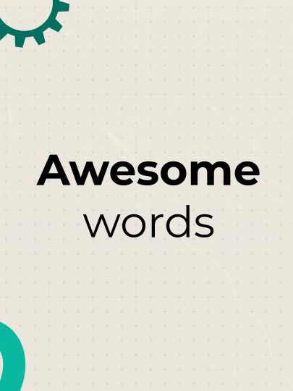
Tablet mockup
You can replace the image on the screen with your own work. Just right-click on it and select “Replace image”

Slide 28

Phone mockup
You can replace the image on the screen with your own work. Just right-click on it and select “Replace image”

Slide 29
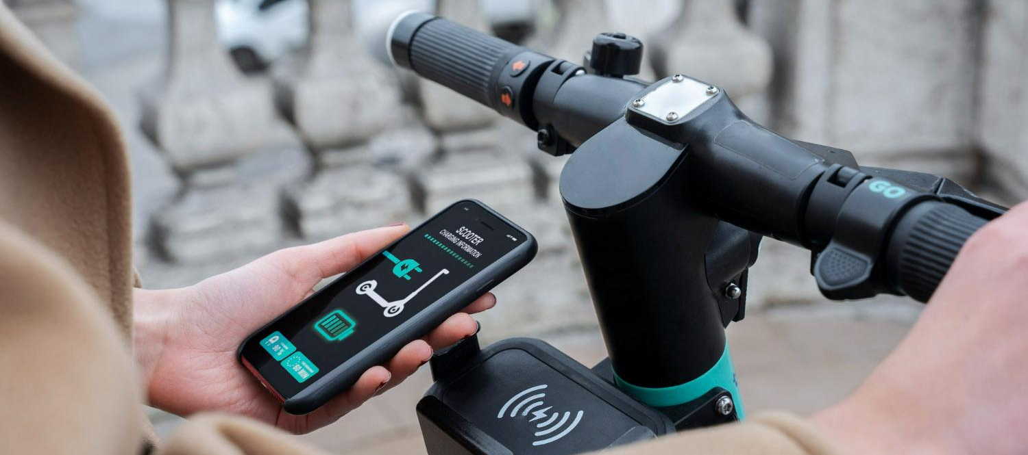
03
Section name
You can enter a subtitle here if you need it

Slide 30
This is a map
Description
Mercury is the closest planet to the Sun
Venus is the second planet from the Sun
Earth is the third planet from the Sun
Despite being red, Mars is actually a very cold place
1
2
3
4

